Slide 1
Arcadia: Literature
Marco Gutierrez, Isabella Lugo, Allie Niegocki, Amanda Prosek, Lexi Wade, Read Wilder

Slide 2
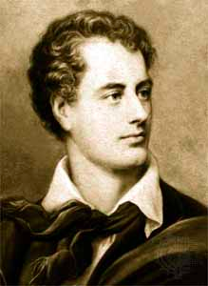
Lord Byron (George Gordon Byron)
1788-1824
Romantic period English poet
first “celebrity” writer => private life and works blurred together
amorous lifestyle and sexual escapades
serves as a contrast to Bernard =>
Bernard is an empty critic who writes to fulfill the needs of his ego; self absorbed and aloof to feelings others have towards him
Byron embodies the opposite of what Bernard’s presence in the book does

Slide 3
Byron, Byron, Byron….why?
Bernard => writing about Byron in hopes of becoming rich and famous => Byron is the reason Bernard came to the Coverly house
mentioned on pages: 34, 36, 45-49, 54, 56-57, 59-61, 76-82, 84-85, 89, 91, 95-96, 105
plot revolves around him
publication of Childe Harold (1812) led to Byron’s fame
poem which tells story of a world-weary man looking for meaning in the world
Byronic Hero: powerful emotion, subject to violence and cynicism, tests society's moral limits
satiric literature parallels Enlightenment/rationalist values with those of Romantic period

Slide 4
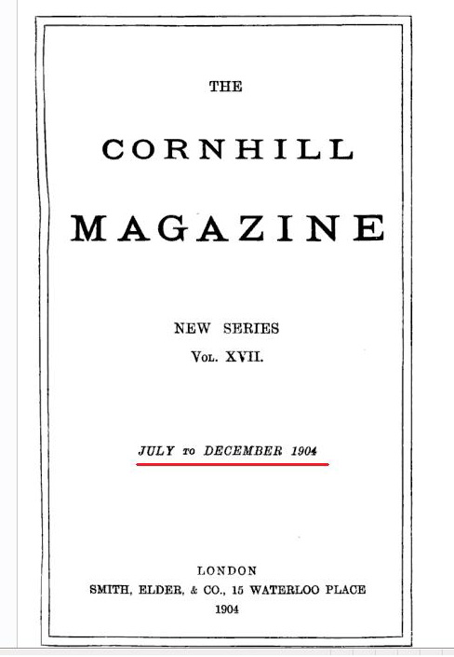
Background
Cornhill Magazine
Victorian Magazine published between 1860 - 1975
Considered one of the most important magazines in the late 1800’s
Combines critical review and excerpts from upcoming novels; host to several famous writers, such as William Makepeace Thackeray, George Eliot, RL Stevenson (R. G. Cox)

Slide 5
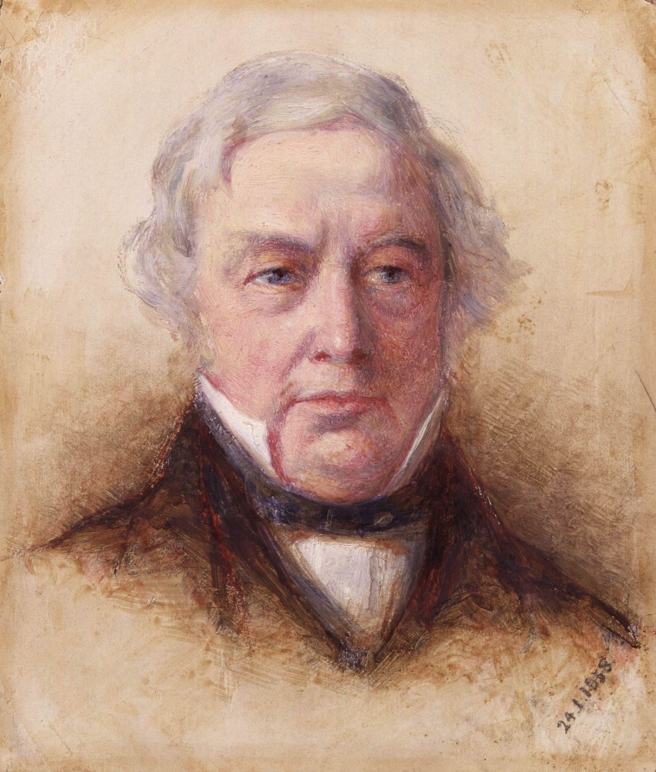
Thomas Love Peacock
Renowned for his use of satire and sexual humor
In “Arcadia,” he refers to Septimus Hodge as “not one of your village simpletons to frighten the ladies; a savant among idiots” in the Cornhill Magazine
Is he being honest?
Double-meaning: Headlong Hall
“assembles a group of eccentrics, each with a single monomaniacal obsession, and derives humor and social satire from their various interactions and conversations” (LibriVox)

Slide 6
Name Drops
Sir Walter Scott
Extremely popular - Septimus claims that Chater will be the same (sarcasm)
Robert Southey
Septimus: “I would shoot him”
Irony? Southey was a famous nemesis of Byron
Circular relationship between guns, Byron, Chater, and affairs
D. H. Lawrence
Name drop for Bernard; doing his best to appear intellectual, when most of what he’s saying is complete nonsense

Slide 7
Virgil
Writer of the Aeneid
An epic detailing the travels of the royal Aeneas after the destruction of Troy and his eventual founding of Rome
Mentioned specifically is Dido, Queen of Carthage and the lover of Aeneas. Thomasina believes the text she is translating describes Dido.
The reference is largely unimportant in the scope of the book. However, it is indicative of the quality of the Latin education and the elite status of the characters.

Slide 8
Aeschylus, Sophocles, Euripedes
The 3 great Athenian tragedians
Inspiration for plays found in Greek mythology and history
Only a small fraction of their body of work remain, the rest destroyed in a fire, a loss which Thomasina laments.
At the very least, their mention in Arcadia furthers the notion that the search for knowledge is a constant, cyclical process occurring over the course of generations.
The reference suggests that Arcadia, sad, if not tragic in its ending, is the successor to the Greek works.

Slide 9
Horace Walpole (pgs 23-24)
Horace Walpole(1717-1797)- English writer- most famous for The Castle of Otranto
The Castle of Otranto is considered to be the first gothic novel which became very popular
It had a dark twist to a love story with death and discovery, the supernatural playing a heavy role within the novel
In reference to Arcadia, Lady Croom, who adamantly dislikes the work Mr. Noakes (the landscape architect) has done to her garden- she refers to it as dark and unruly in terms of the context of the novel
Notes:
http://www.britannica.com/biography/Horace-Walpole-4th-earl-of-Orford
https://hannahackroyd.wordpress.com/2012/09/04/the-castle-of-otranto-by-horace-walpole/#more-836

Slide 10
Humphry Repton's “Red Books”
Humphry Repton(1752-1818)- landscape designer and watercolor artist and quite famous in his day and age
Inspiration from the Picturesque movement- more wild and a transition from yard to house through steps and terraces
“Red Books” were a series of three volumes within which had illustrated and written out details for his clients’ projects
Is used as a reference to compare Noakes’ works and his landscape book
Notes:
http://www.britannica.com/biography/Humphry-Repton
http://www.themorgan.org/collection/Humphry-Reptons-Red-Books

Slide 11
Miscellaneous Fictional Works
Brighton and Hove Argus
English Newspaper
D.H Lawrence probably wrote it
Tech to find out who wrote things
Maid of Turkey
Chater wrote it
Probably bad
Septimus wouldn’t feed it to his dog for dinner

Slide 12
Couch of Eros
The Facts
“Sex Couch”
Poem written by Mr. Chater
Nobody liked him/it
Probably really bad
He was a florist, not a poet
Brice paid for it to be published
The Importance
Septimus and Chater’s first onstage encounter
Bernard and Hannah
Inscription vs. review
Where did Byron get it

Slide 13
Piccadilly Recreation
A publication that puts out book reviews and satyrs
Septimus and Byron occasionally write for it
Scathing review of “The Maid of Turkey”
That time Septimus got busy with Chater’s wife and then STILL wrote a bad review of Chater’s other book

Slide 14
Works Cited
"Headlong Hall (dramatic Reading)." LibriVox. LibriVox. Web. 21 Jan. 2016. <https://librivox.org/headlong-hall-by-thomas-love-peacock/>.
Cox, R. G., and Spencer L. Eddy. "The Cornhill Magazine." The Cornhill Magazine. The Victorian Web, 13 Aug. 2005. Web. 21 Jan. 2016. <http://www.victorianweb.org/periodicals/cornhill/cornhill.html>.
"George Gordon Byron." Poets.org. Academy of American Poets, n.d. Web. 26 Jan. 2016.
"Lord Byron (George Gordon)." Poetry Foundation. Poetry Foundation, n.d. Web. 26 Jan. 2016.
"Humphry Repton | British Landscape Designer." Encyclopedia Britannica Online. Encyclopedia Britannica. Web. 27 Jan. 2016.
"Humphry Repton's Red Books." Humphry Repton's Red Books. Web. 27 Jan. 2016.
"A Glossary." A Glossary. Web. 27 Jan. 2016. <http://www.skidmore.edu/academics/theater/productions/arcadia/I.i.html>.

